Slide 1
CHATBOT USING WATSON SERVICES
GUIDED BY : PRESENTED BY:
DR. SUBHASISH MOHAPATRA SANGHAMITRA HOTA
HEAD OF THE DEPARTEMENT, 1501106521
CET,BHUBANESWAR

Slide 2
TOPICS TO COVER
WHAT IS A CHATBOT
HISTORY OF CHATBOT
ARCHITECTURE OF CHATBOT
BOT BUILDING PLATFORMS
STEPS INVOLVED
DEMO OF CHATBOT I MADE
ADVANTAGES AND DISADVANTAGE
FUTURE OF CHATBOT
REFERENCES

Slide 3
WHAT IS A CHATBOT
CHATBOT IS A COMPUTER PROGRAM DESIGNED TO STIMULATE A CONVERSATION WITH HUMAN USERS,ESPECIALLY OVER INTERNET.
CHATBOT IS GENERALLY MEANT TO UNDERSTAND HUMAN LANGUAGE ,RESPOND TO IT MORE TO IT MORE HUMAN-LY AND LEARN ALONG THE WAY.
SIRI, GOOGLE ASSISTANT ARE CLASSIC EXAMPLE OF CHAT BOT.

Slide 4
HISTORY OF CHATBOT
IT IS THERE SINCE 1950’s.
ELIZA WAS THE FIRST CHATBOT TO PROVE THE POTENTIAL OF CHATBOTS
ELIZA SIMULATES CONVERSATION BY IMPLEMENTING PATTERN MATCHING AND A SUBSTITUTION METHODOLOGY THAT GIVES USERS AN ILLUSION OF UNDERSTANDING ON THE PART OF THE PROGRAM.
FOR EXAMPLE : IF I ASK WHAT IS YOUR NAME? IT IS GOING TO SEARCH THE KEYWORDS FROM DATABASE AND GIVE SUITABLE RANDOM RESPONSES LIKE “MY NAME IS ECHOBOT OR HEY, ITS ECHOBOT.”

Slide 5
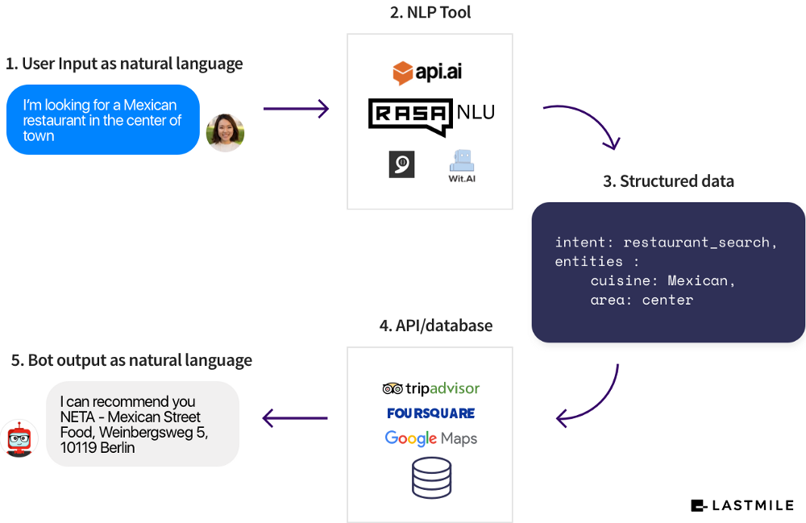
ARCHITECTURE OF CHATBOTS
CHATBOT ARCHITECTURE IS SIMILAR TO THAT OF A WEB ARCHITECTURE.
IT WORKS ON CLIENT-SERVER MODEL.
THE DIFFERENTIATING FACTOR IS THE UNSTRUCTURED DATA. (RAW DATA GIVEN AS INPUT)

Slide 6
BOT BUILDING PLATFORMS
THESE ARE THE MARVELOUS PLATFORMS THAT HELP TO DESIGN CONVERSATION SCENARIOS AND THE CORRESPONDING RESPONSES.
THEY USE A MIXTURE OF AI AND MACHINE LEARNING ALGORITHMS TO MAKE BOTS UNDERSTAND THE NATURAL LANGUAGE (NATURAL LANGUAGE UNDERSTANDING) ,PROCESS THE CONVERSATIONS AND GET THE RESULTS (NATURAL LANGUAGE PROCESSING) AND GENERATE RESPOND TO THE USERS (NATURAL LANGUAGE GENERATION).
SOME OF THE PLATFORMS ARE DIALOG FLOWS, ACTION OF GOOGLE, WATSON CONVERSATION, RASA NLU & RASA CORE.

Slide 7
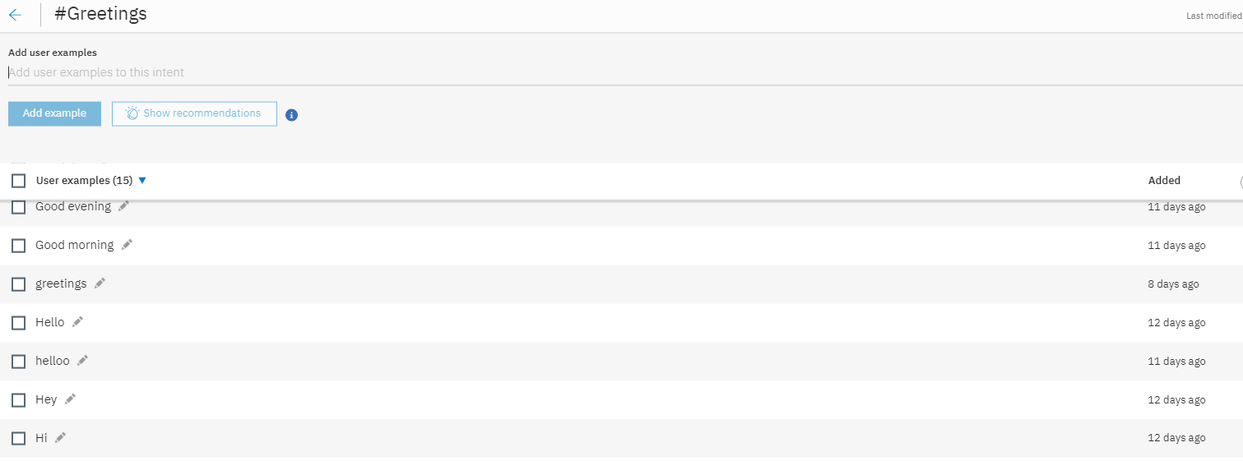
STEPS OF BUILDING CHATBOT (Using Watson)
CREATING INTENTS.
IT IS A COLLECTION OF EXPRESSIONS THAT ARE SYNONYMS TO EACH OTHER BUT CONSTRUCTED DIFFERENTLY

Slide 8
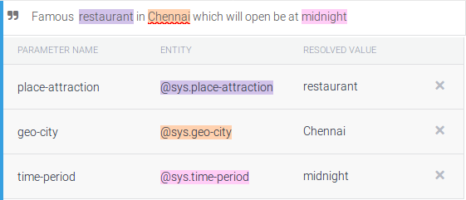
2. CHOOSING ENTITIES
ENTITY IS THE INFORMATION EXTRACTED FROM INTENTS.
DETAILS WE WANT THE BOT TO CAPTURE
FOR EG: SEARCHING A PLACE IN CITY.

Slide 9
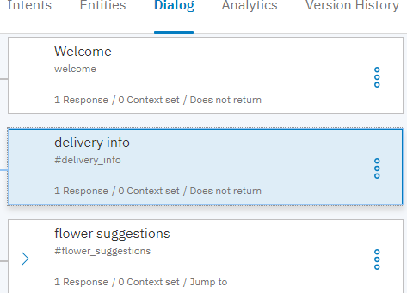
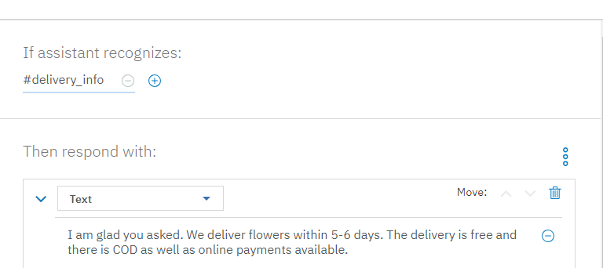
3. DIALOGUES
RESPONSES WE WANT THE CHATBOT TO GIVE BACK TO USERS.

Slide 10
4.DEPLOYING
AFTER ALL THE STEPS ARE OVER, WE CAN DEPLOY IT IN ANY PLATFORMS EASILY LIKE MESSENGER, DISCORD,SLACK , WORDPRESS.

Slide 11
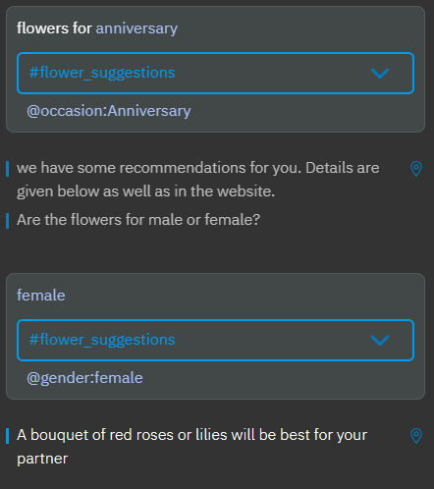
NLU BEHIND CHATBOTS
NLU SEGMENTS A SENTENCES AND TRIES TO ESTIMATE THE INTENT OF THE SENTENCE; MATCHING ENTITIES, AND PHRASES WITHIN.
BASED ON LEARNING EXPERIENCES, NLU GIVES PROBABILITY SCORES OF THE SENTENCE’S INTENTIONS AND ENTITIES.

Slide 12
ADVANTAGES DISADVANTAGES
PRICING :WATSON HAS PAY AS YOU GO SERVICE.
MAKING CHANGES IN THE API IS DIFFICULT.
NLU PRECISION TO ABOUT 95% ACCURACY.
STORES DATABASE IN IBM CLOUD.
HAS ENOUGH SERVICES FOR FREE.
SUPPORTS MULTIPLE USERS AT THE SAME TIME
EASIER TO UNDERSTAND.

Slide 13
EXTENSIONS IN FUTURE
CAN BE USED TO EDUCATE PEOPLE ABOUT SOME SPECIFIC LESS TALKED TOPICS
CAN BE USED TO AUTOMATE EMAILS
CAN BE USED FOR WIPING OUT CUSTOMER SERVICE

Slide 14
REFERENCES
THE FOLLOWING RESOURCES GREATLY HELPED ME IN FINISHING THE REPORT:
Computer History Museum (2006), "Internet History—1970's" , Exhibits , Computer
History Museum , archived from the original on 2008-02-21, retrieved 2008-03-05
Güzeldere, Güven; Franchi, Stefano (1995-07-24), "Constructions of the Mind" , Stanford
Humanities Review , SEHR, Stanford University , 4 (2), retrieved 2008-03-05
Mauldin, Michael (1994), "ChatterBots, TinyMuds, and the Turing Test: Entering the
Loebner Prize Competition", Proceedings of the Eleventh National Conference on
Artificial Intelligence , AAAI Press , retrieved 2008-03-05 ( abstract )

Slide 15
THANK YOU

